Slide 1
Lesson 4.1
Addressing Water Pollution
www.tu.org/headwaters © 2025 Trout Unlimited. Any use of the text or images this document contains without permission of 2025 Trout Unlimited is prohibited.

Slide 2
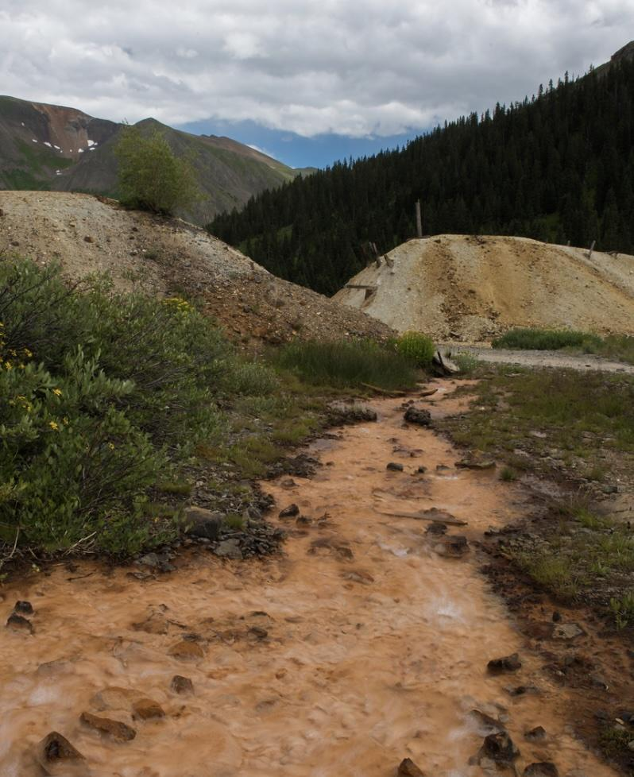
Sources of water pollution
Pollution is the presence of chemicals or microbes that are harmful to an ecosystem or humans.
Generally, pollution is anthropogenic which means it is caused by human activity.
Sources of water pollution can be divided into two categories:
Point source pollution comes from a single, identifiable source like a factory or chemical spill.
Nonpoint source pollution comes from multiple, diffuse sources like car exhaust or fertilizers spread on lawns in a neighborhood.
© 2015 Josh Duplechian, Trout Unlimited

Slide 3
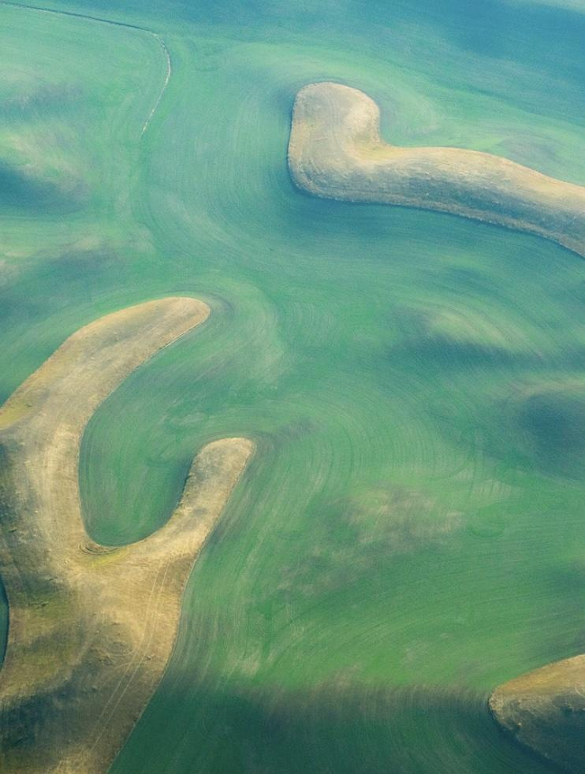
Eutrophication
Eutrophication occurs when excess nutrients like nitrates and phosphates are added to an aquatic ecosystem.
These nutrients can come from:
fertilizers added to farm fields or lawns that run off during rain events
intensive livestock farming
malfunctioning or insufficient sewage treatment systems
© 2022 Trout Unlimited

Slide 4
Eutrophication (continued)
When added to aquatic environments, excess nutrients cause:
excess algae to grow (algae bloom) which blocks sunlight, killing plants below
algae blooms dies all at once
both effects lead to massive decomposition which uses up all the oxygen
causes an anoxic (low oxygen) zone where living things are stressed, die or move out
© 2022 Trout Unlimited

Slide 5
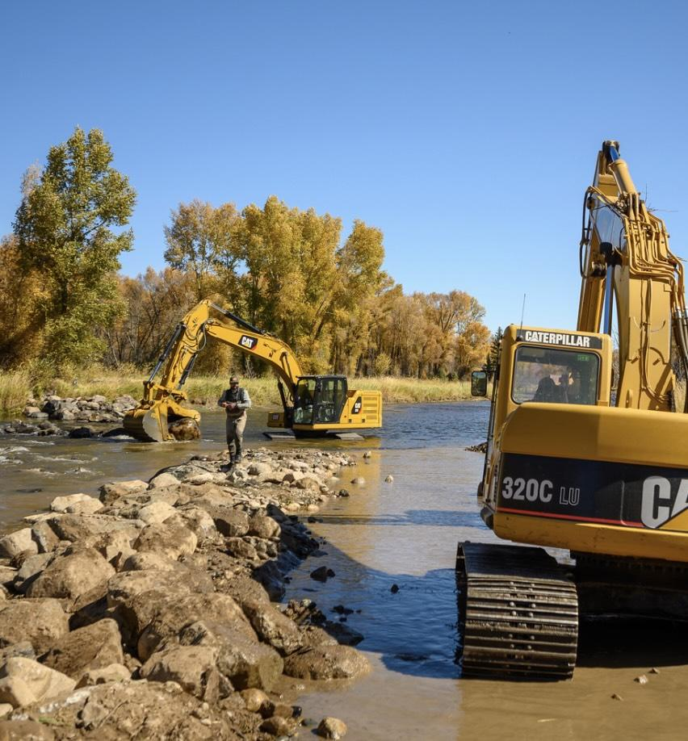
Sedimentation
Sedimentation is when runoff brings small soil particles like mud or clay into stream.
This can come from anthropogenic sources (construction sites or roads) or natural sources (clay or mud seams in the ground).
Sedimentation can harm trout by:
disrupting insect and plant life.
covering gravel beds needed for spawning.
© 2019 Josh Duplechian, Trout Unlimited

Slide 6
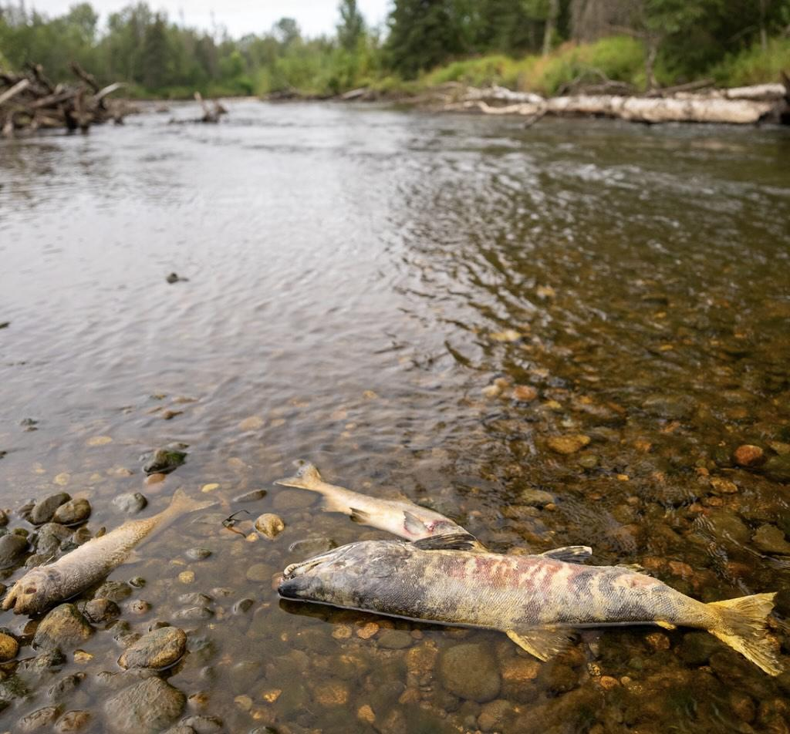
Acid rain
Acid rain is caused by burning fossil fuels, particularly coal.
Combustion releases sulfur dioxide and nitrogen oxides into the atmosphere.
In clouds, these molecules dissolve into water droplets, making rain slightly acidic (lower pH).
Precipitation falls and drains into streams and lakes, lowering the pH of the water which can stress or kill aquatic organisms.
© 2023 Josh Duplechian, Trout Unlimited

Slide 7
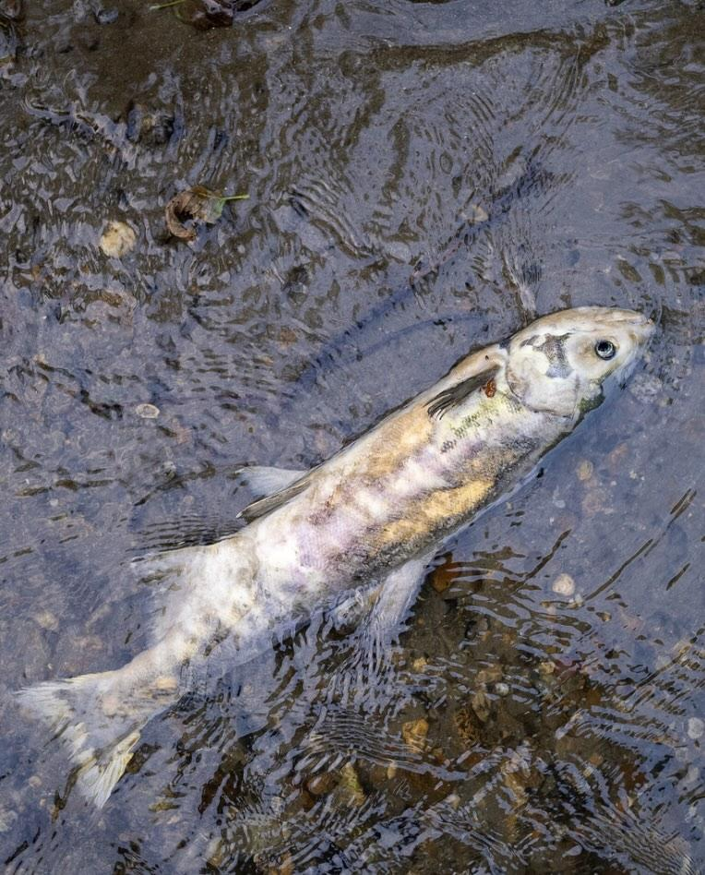
Toxins
Toxic chemicals released into streams can include:
mercury (primarily from coal-burning power plants)
arsenic (can come from mining activities)
PCBs (industrial chemicals).
Depending on the type of toxin and the dose, these chemicals can be lethal to aquatic organisms.
© 2023 Josh Duplechian, Trout Unlimited

Slide 8
Toxins (continued)
If the toxin or dosage is not lethal, some chemicals can build up in the tissues of organisms, a process called bioaccumulation.
If a toxin bioaccumulates in organisms lower on the trophic pyramid, then higher level consumers can have even greater levels of toxins in their tissues after they eat many prey organisms, a process called biomagnification.
© 2023 Josh Duplechian, Trout Unlimited

Slide 9
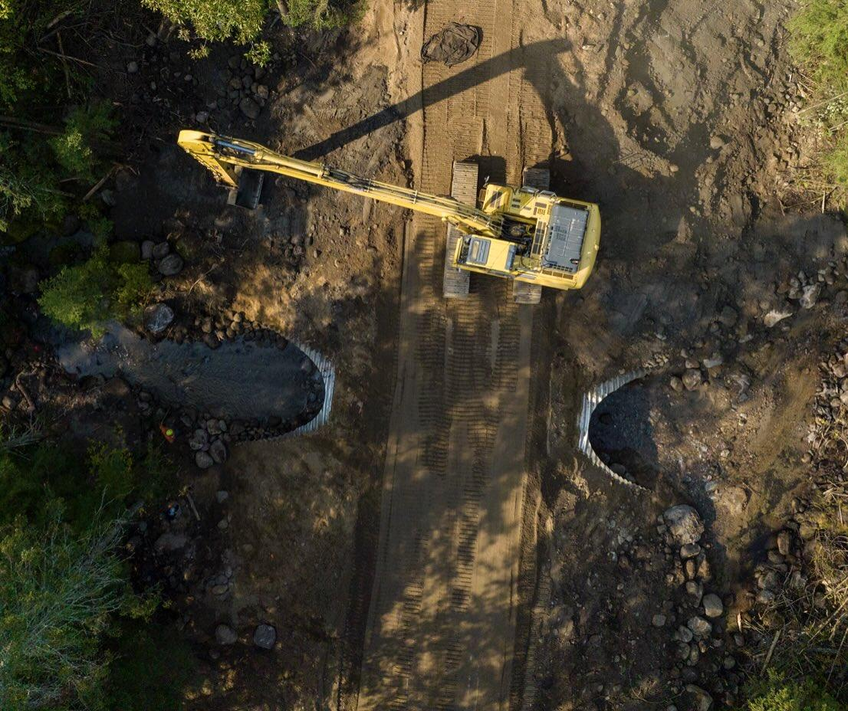
Strategies for mitigating pollution
Like all types of pollution, water pollution can be managed in three ways:
altering human activity to reduce the amount of pollution produced
controlling the release of pollution so it does not enter the water after being produced.
cleaning up or restoring water after the pollution has been introduced to the ecosystem
© 2022 Trout Unlimited

Slide 10
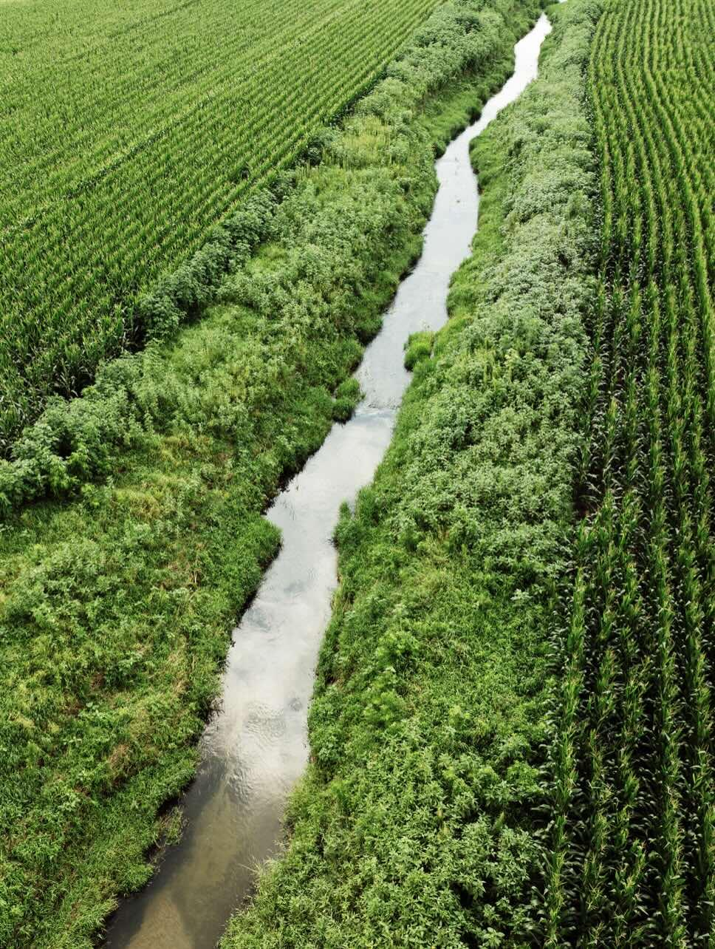
Pollution mitigation example: riparian buffers
One of the most common and effective ways to prevent pollutants from entering a waterway is to protect or replace a strip of vegetation along both sides of a stream, an area called a riparian buffer.
After a rain event, runoff flows towards the stream, but plants in the riparian buffer slow down the flow and give the water a chance to infiltrate. Any pollutants in the water are trapped in the soil and have a chance to break down before they get into the water.
This is particularly important on farms so fertilizer and pesticides do not enter waterways.
© 2024 Justin Carfagnini, Trout Unlimited

