Slide 1
Lesson 3.2
Understanding the Trout Life Cycle
www.tu.org/headwaters © 2025 Trout Unlimited. Any use of the text or images this document contains without permission of 2025 Trout Unlimited is prohibited.

Slide 2
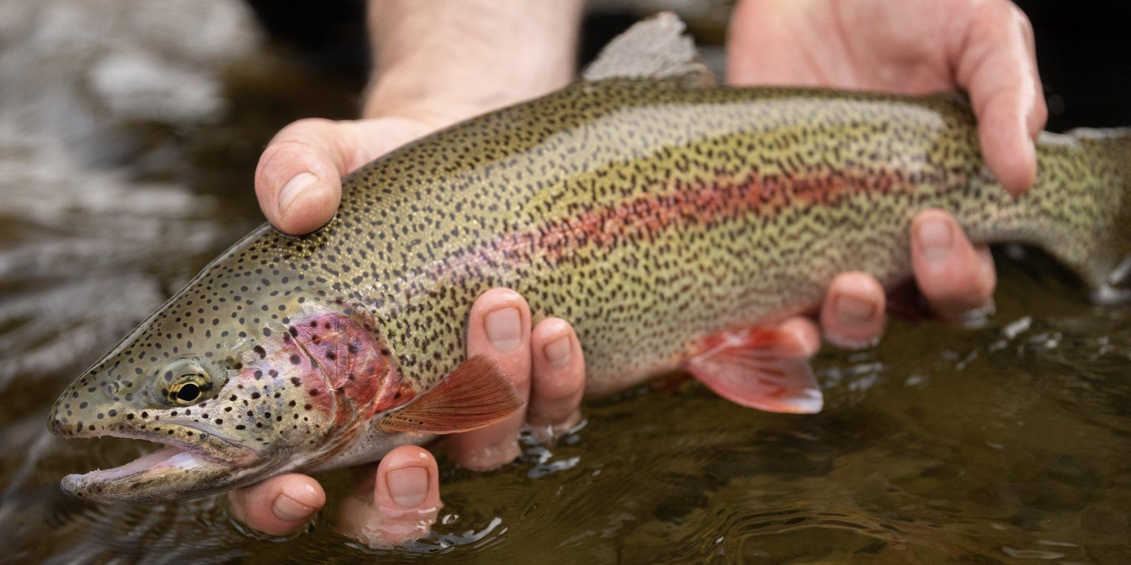
Species
The biological definition of a species is a group of organisms that can mate and produce fertile offspring.
In scientific classification, first proposed by Carl Linnaeus in 1758, each species is given a two word Latin name:
first word (capitalized and italicized) identifies the genus
second word (lower case and italicized) identifies the species
Example: the rainbow trout is Oncorhynchus mykiss.
© 2023 Josh Duplechian, Trout Unlimited

Slide 3
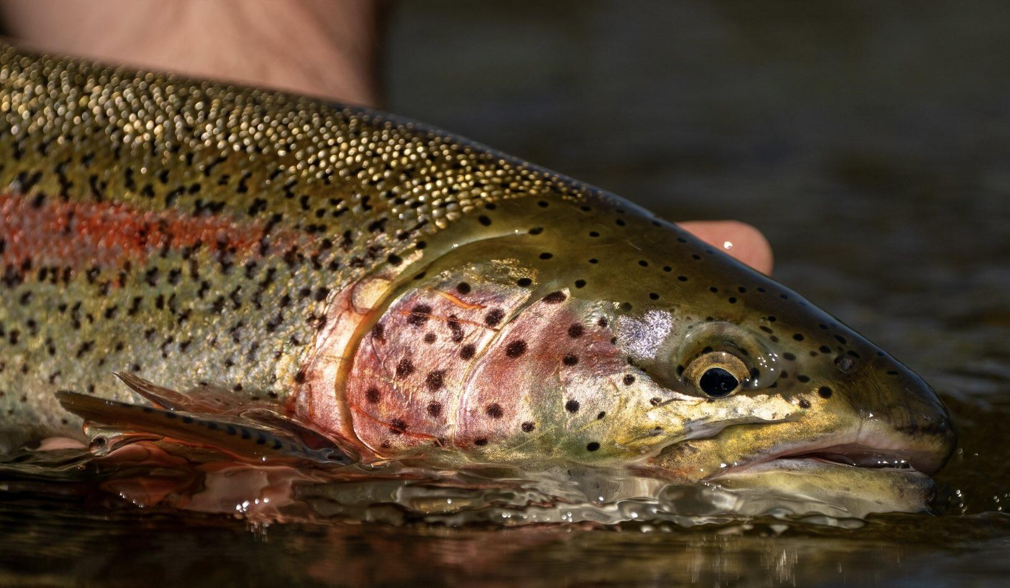
Species (continued)
Closely related species can interbreed, producing offspring that are called hybrids that can be fertile.
Within species there can be geographically isolated populations called subspecies which:
have significantly different physical and genetic characteristics adapted to the local environment
but still are within the same species as other populations
and can be given a third Latin name after the species name such as:
redband trout (Oncorhynchus mykiss gairdneri)
Little Kern River golden trout (Oncorhynchus mykiss whitei)
© 2023 Josh Duplechian, Trout Unlimited

Slide 4
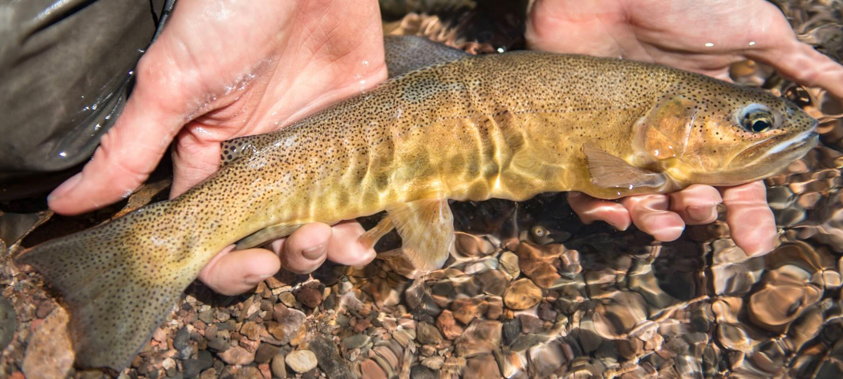
Species (continued)
There is debate about what constitutes a species compared to a subspecies.
Classification for trout species, and indeed all animal and plant species, changes as new information becomes available, particularly genetic information.
Taxonomists (scientists who classify species) attempt to have classifications match evolutionary history as closely as possible.
© 2017 Josh Duplechian, Trout Unlimited

Slide 5
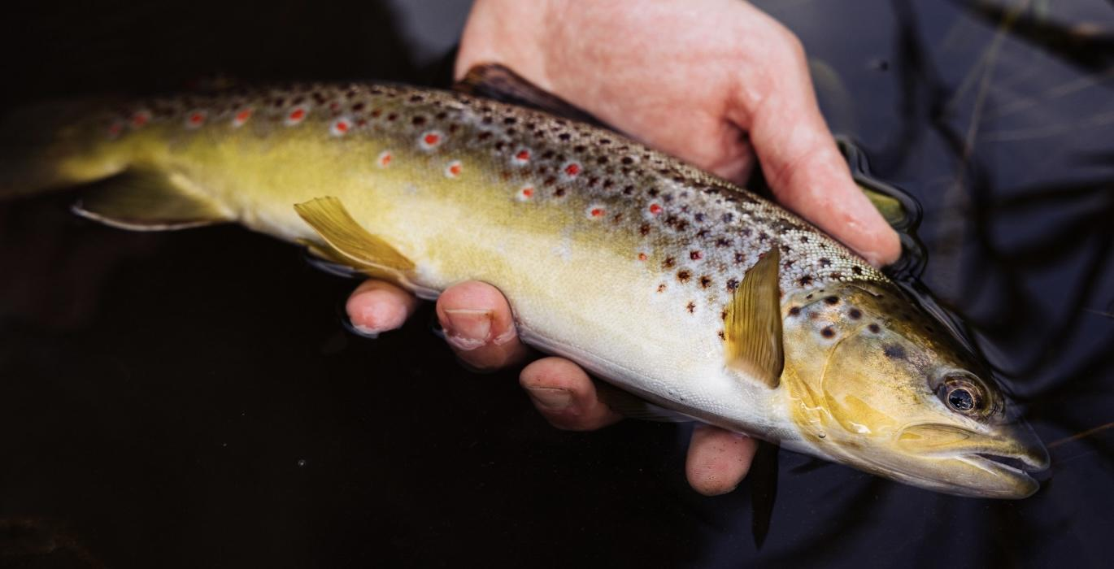
Salmonids
Salmonid is a category of species in the family Salmonidae that encompasses closely related families of:
Trout
Salmon
Char
Grayling
Whitefish
Lenok
Taimen
Just within trout, salmon and char, there are as many as 120 recognized species.
© 2024 Justin Carfagnini, Trout Unlimited

Slide 6
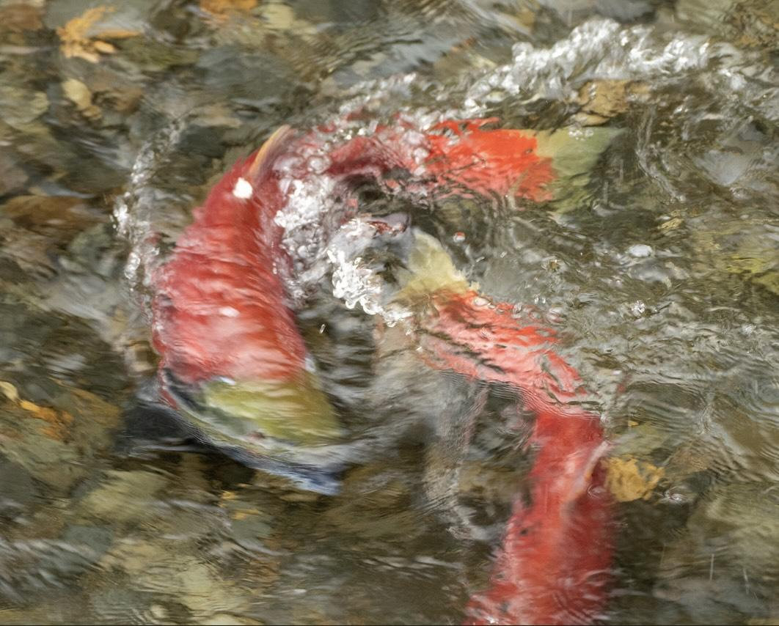
Salmonid life cycle
Salmonids breed in freshwater streams, usually in gravel beds in flowing water.
With her tail, the female removes sediment and digs a shallow nest in the gravel called a redd.
When ready, she lays her eggs in the redd and then a male fertilizes the eggs by spreading milt containing his sperm over the eggs. The female then covers the eggs with a layer of gravel and will sometimes guard the redd to prevent the eggs from being eaten by predators.
© 2023 Josh Duplechian, Trout Unlimited

Slide 7
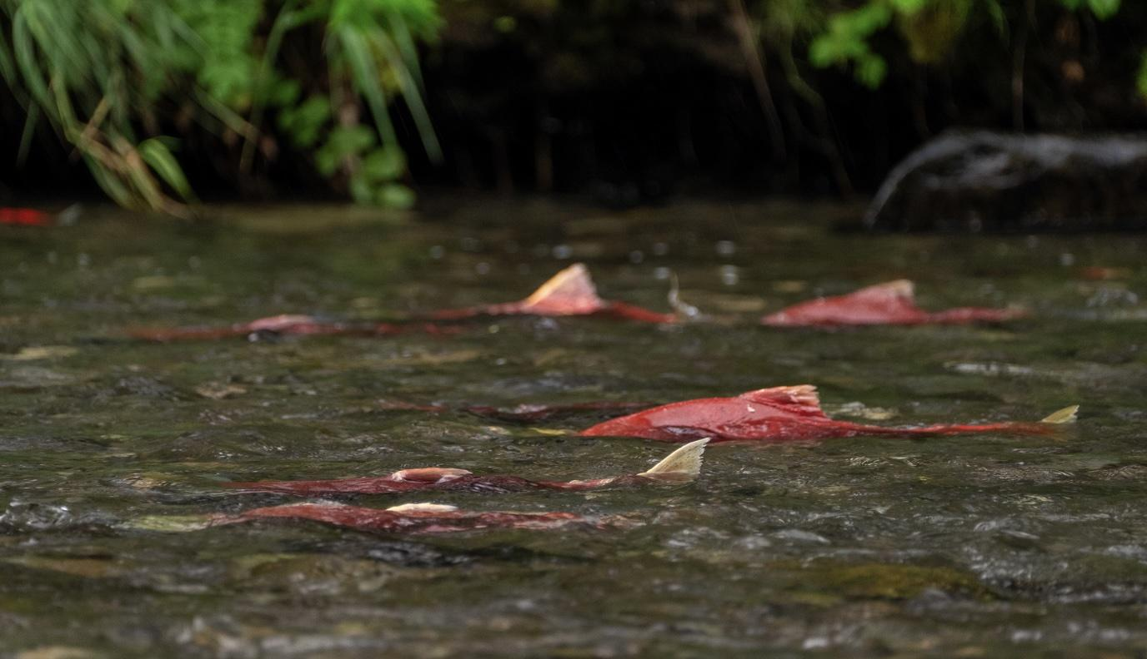
Salmonid life cycle (continued)
Depending on the species and the location, trout spawn at different times of year. Generally:
brook and brown trout spawn in the fall.
rainbow and cutthroat trout spawn in the spring.
salmon can spawn at all times of the year depending on the latitude and local climatic conditions.
© 2023 Josh Duplechian, Trout Unlimited

Slide 8
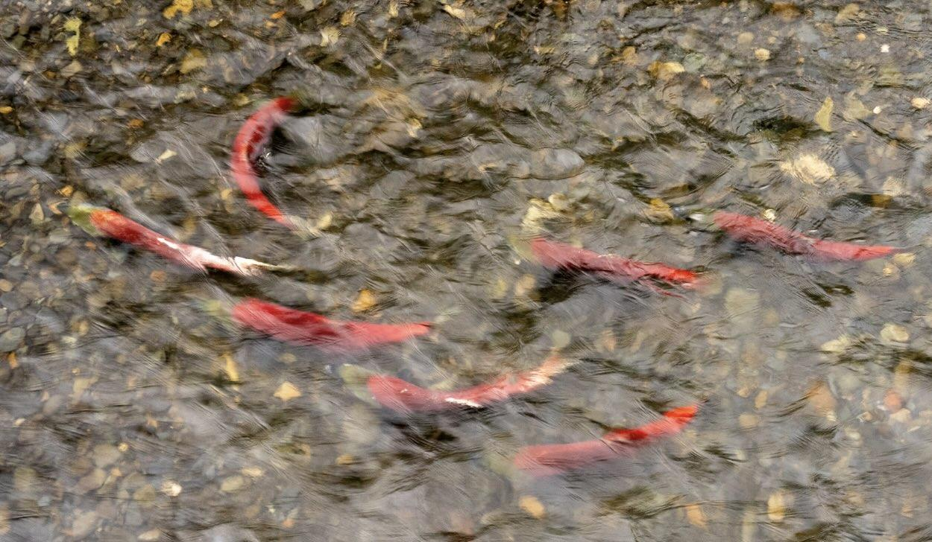
Salmonid life cycle (continued)
Depending on the species, water temperature and other factors, eggs hatch between 4 and 20 weeks later.
The fish are then in the alevin stage and still have a yolk attached to their bodies for up to five weeks providing nutrients for rapid growth.
After the yolk is absorbed, the fish are called fry and live in the river eating small pieces of detritus and insects.
© 2023 Josh Duplechian, Trout Unlimited

Slide 9
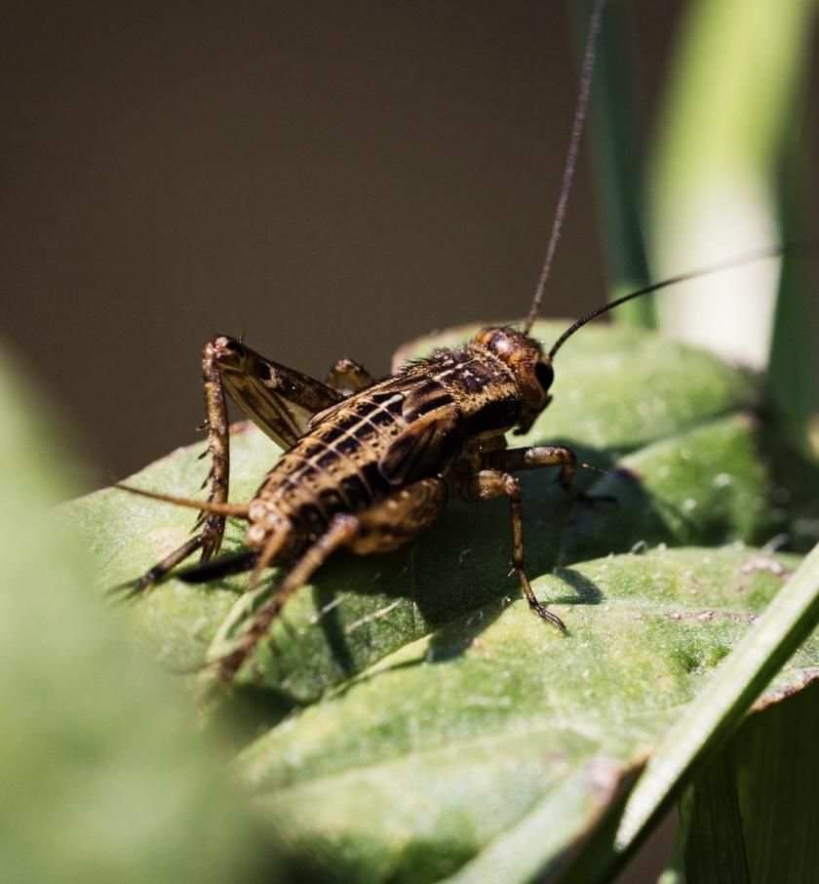
Salmonid life cycle (continued)
As they get larger, trout and salmon consume larger aquatic insects, terrestrial insects like grasshoppers or ants that fall in the river, small fish (including other trout), frogs and crayfish.
Salmonids continue to grow throughout their lifespan which depends on the species and the local conditions, but can range from three years for brook trout in small streams to over 60 years for a lake trout in a large lake.
© 2024 Justin Carfagnini, Trout Unlimited

Slide 10
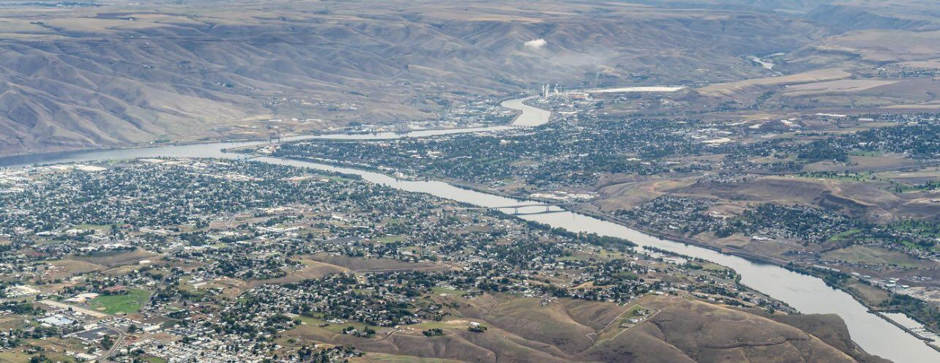
Salmonid migration
Salmonids are all migratory species.
Some populations migrate to different parts of a river during different parts of their life.
Others migrate from rivers to a lake and back.
Others, such as salmon and sea-run trout, migrate to the sea during much of their adult life to take advantage of the large amounts of food available in the ocean. A life cycle that includes migration to and from the ocean is known as anadromous.
© 2023 EcoFlight, Trout Unlimited

Slide 11
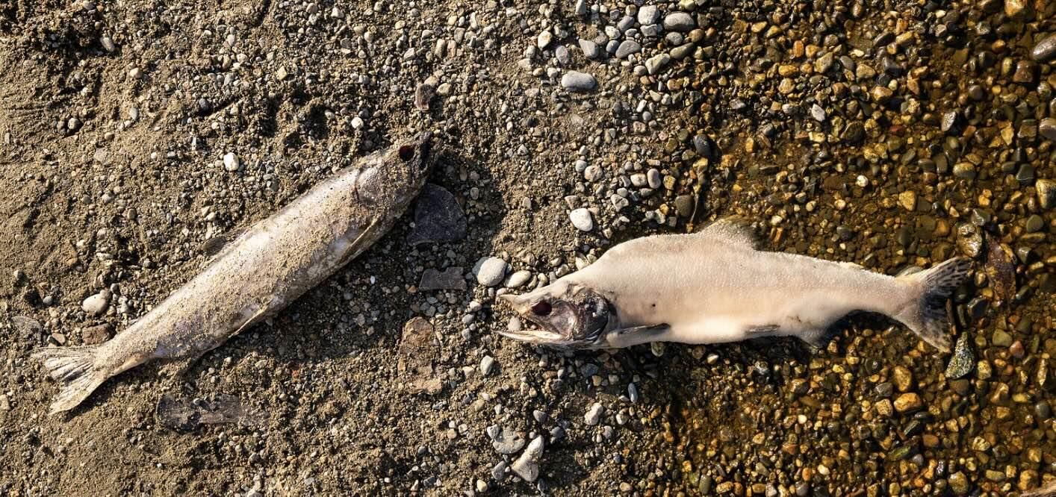
Salmonid migration (continued)
Pacific salmon species:
hatch in rivers
travel to the sea after a year or two
spend most of their life in the ocean getting big due to abundant food
return to the river in which they were hatched to spawn (lay or fertilize eggs)
die
Atlantic salmon have a similar life cycle, but can spawn multiple times.
© 2023 Josh Duplechian, Trout Unlimited

Slide 12
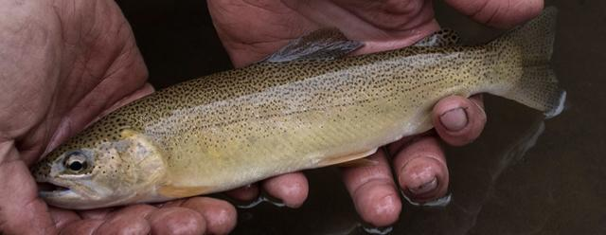
Endangered species
Some trout species are very local and are threatened by environmental factors such as:
habitat loss
invasive species
warming waters due to climate change.
The Endangered Species Act of 1973 lays out legal protections for endangered species and tasks the U.S. Fish and Wildlife Service with developing and executing a recovery plan for all listed species.
For example, bull trout which live in rivers and lakes in the far north of the continental U.S. and need very cold water are listed as “threatened.”
© 2017 Josh Duplechian, Trout Unlimited

