Slide 1
Lesson 2.1
Understanding the Hydrologic Cycle
www.tu.org/headwaters © 2025 Trout Unlimited. Any use of the text or images this document contains without permission of 2025 Trout Unlimited is prohibited.

Slide 2
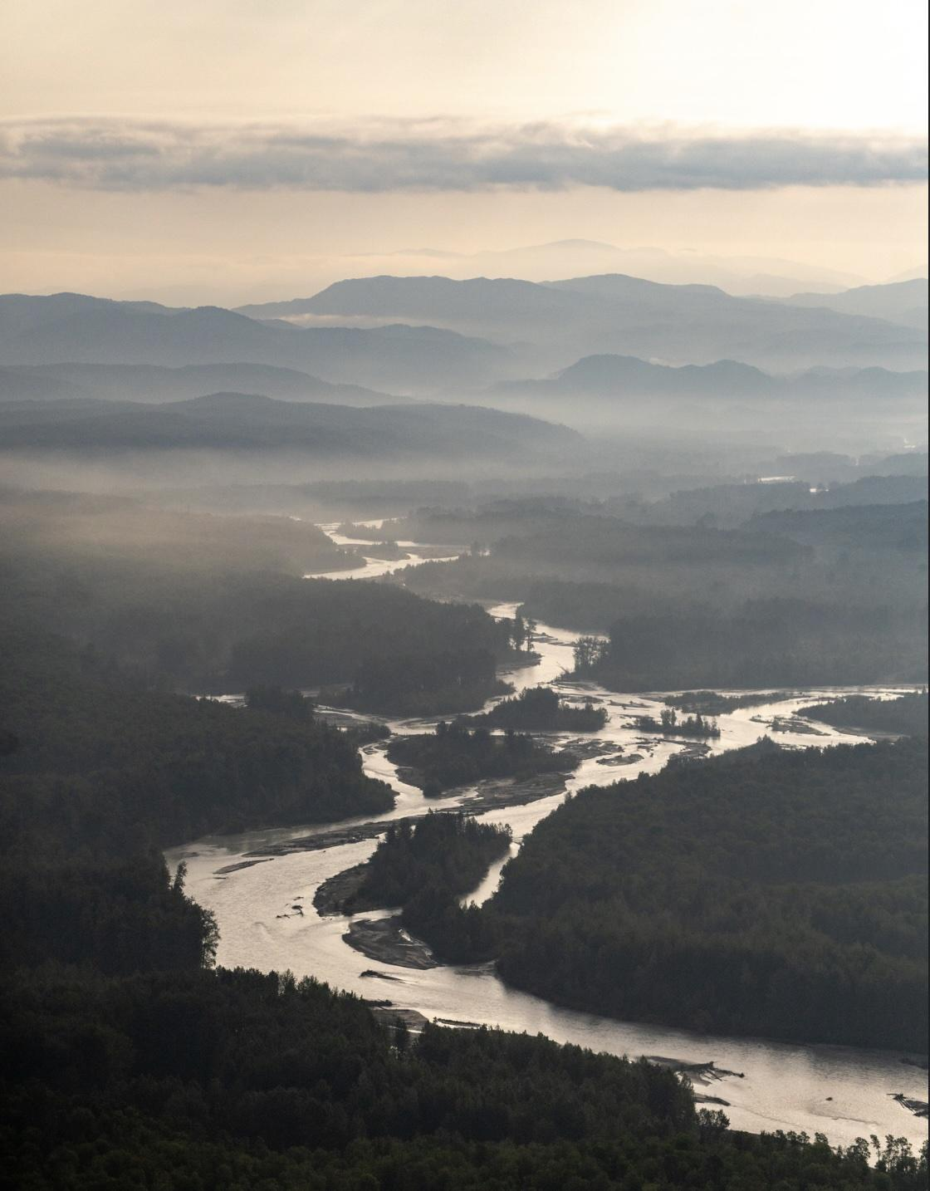
Hydrologic (water) cycle
The hydrologic cycle is the movement of water molecules to and from different storages and the transition between gaseous, liquid and solid states powered by the sun.
Like any nutrient flow, the hydrologic cycle can be broken down into storages (places where water resides) and flows (processes than move water from one storage to another).
© 2023 Josh Duplechian, Trout Unlimited

Slide 3
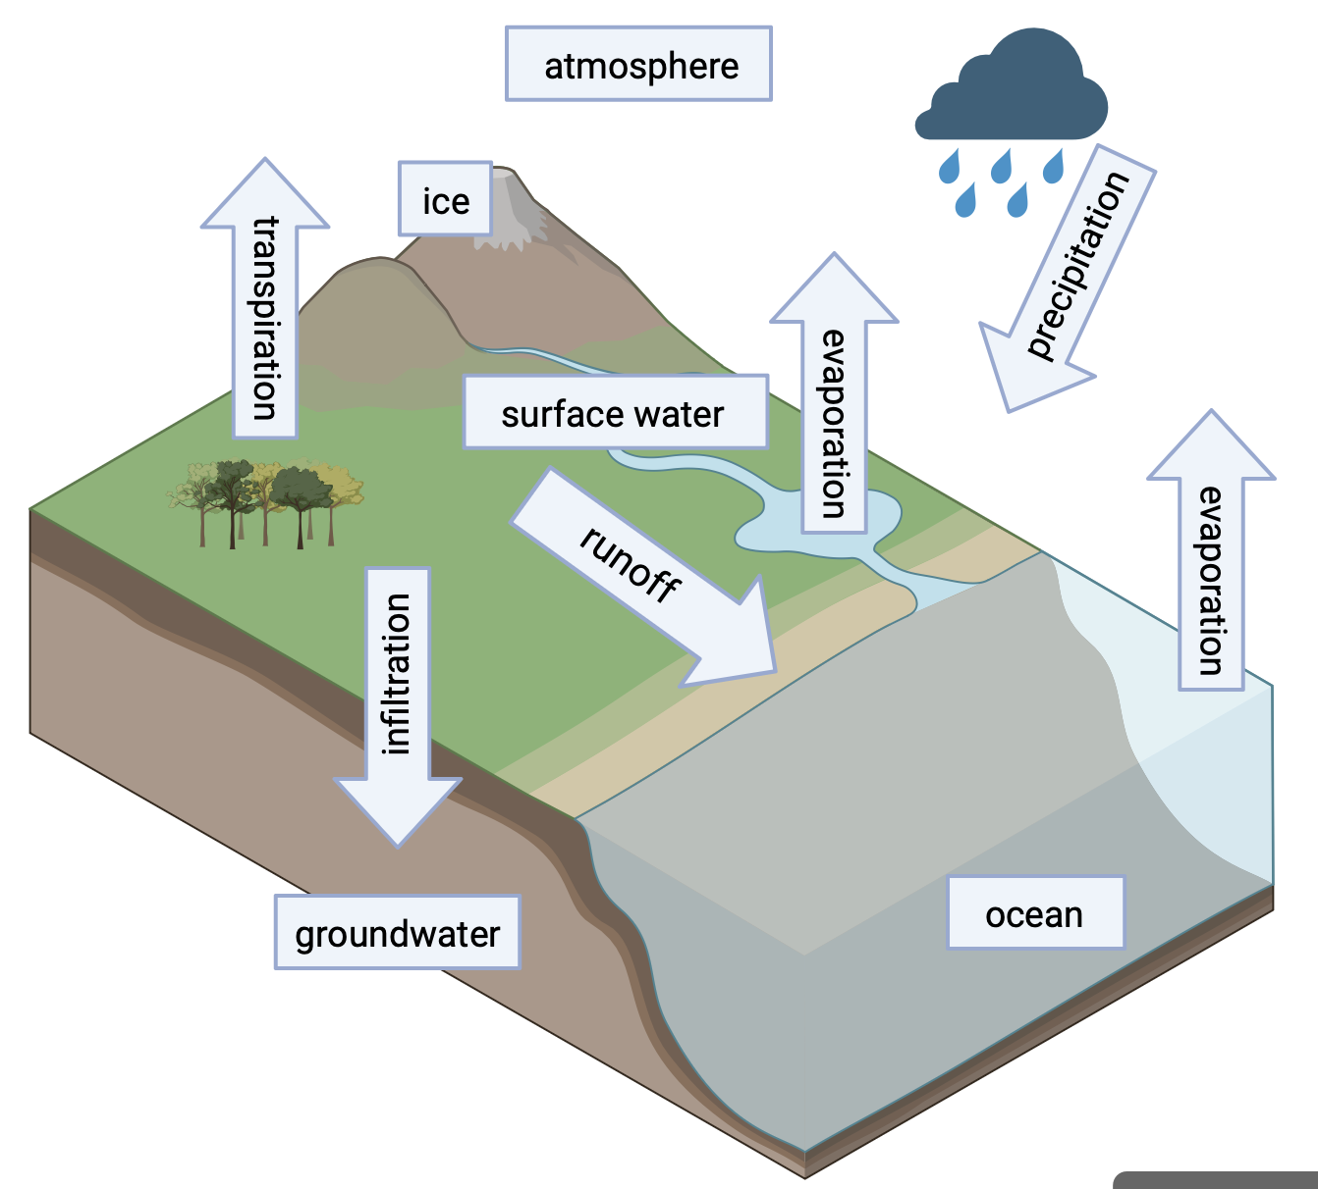
Hydrologic (water) cycle storages
Water storages include:
the ocean
surface water such as lakes and rivers
ice such as glaciers and ice caps
groundwater (underground water contained in the empty spaces between soil particles and rock fissures)
atmospheric water vapor
© 2025 Trout Unlimited

Slide 4
Hydrologic (water) cycle flows
Water flows include:
precipitation (liquid water condensing from water vapor and falling from the atmosphere to the Earth’s surface)
evaporation (liquid water at the surface becoming water vapor in the atmosphere)
transpiration (water vapor escaping from plants)
© 2025 Trout Unlimited

Slide 5
Hydrologic (water) cycle flows continued
runoff (water that remains on the Earth’s surface and runs downhill such as streams and rivers)
infiltration (water that soaks into the soil and ends up as groundwater)
© 2025 Trout Unlimited

